Slide 1


BUSINESS PLAN TEMPLATE
We have created this business plan template for you and your team explaining the key points that should be there. This template is basic and it is optional to use.

Slide 2



BUSINESS' NAME
A tag line / Name of the participants

Slide 3
PROBLEM STATEMENT
What is the problem you are trying to solve?

Slide 4

MISSION, VISION, AND VALUES
Mission
Vision
Values
Mission is the reason why your company exists. It is the visible and tangible effect you want your company to create for your customers and the world.
Vision is what success looks like for your company. It is what your company aspires to be in the future. It is how the world will look like once you've accomplished your mission.
These are the guiding principles that will influence your actions to fulfill your company's mission and vision.

Slide 5
1.
Feature 1
2
KEY FEATURES
Feature 2
3
What are the main features of your product? What makes it different?
Feature 3
4
Feature 4

Slide 6
Marketing
MARKET AND COMPETITOR ANALYSIS
How are you different from your competitors? What they lack and you don't?

Slide 7
Explain how you'll market the product or service.
Product refers to the good or service you are offering to customers. What needs does this product fulfil? What frustrations does it address? What makes it compelling to customers such that they will believe they need to have it?
Price is what customers pay for a product or service and it takes into account the cost of production. What is the value of the product or service to customers? Are there established price points for this product or service in the market? How will this price compare with competitors?
Price
Product
PRICE
DISCOUNTS
BUNDLING DEALS
CREDIT TERMS
BRAND
FEATURES
PACKAGING
Place refers to how and where your customers will look to see your product or service. It also considers how you will deliver the product or service to them. Will it be in a physical store or online? What will be the distribution channels?
Promotion
Promotion is how you will get the word out about your product or service to your target customers. It includes advertising, public relations, and promotional strategies.
Product
ADS
PRS
OCIAL MEDIA
EMAIL SEARCH
ENGINEVIDEO
STORES
WEBSITE
ONLINE
MARKETPLACE

Slide 8
Demographics
Buying Roles
Goals and Responsibilities
Needs
(Gender, age, marital status, employer)
(Decision makers, influencers)
Objections
Frustrations
Buyer's Journey
Channels
Sources of information
(Awareness, consideration, purchase, advocacy)
(Social media, other digital activities,non-digital activities)
(Content that influences purchasedecisions)

Slide 9
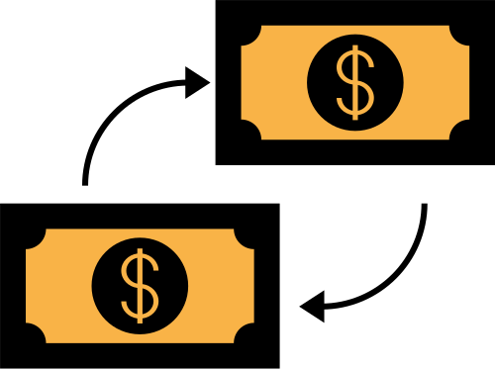
FINANCIAL PROJECTIONS
How much does your product cost? What is your gross profit margin? How many users do you expect to have by 2025?

Slide 10
FUTURE GOALS
Write your predictions and future goals about the business model here. How do you think and want your idea to unfold?

Slide 11
CEO
Your
Name, Bio
Director
Team
Name, Bio
Director
Description
Name, Bio

Slide 12
THANK YOU!
Add a quote here or thank you note or just your team's name.

